Slide 1

VoiceBridge: Emotion-Aware Bidirectional Sign Language–Speech System
Bhavya Ullas
Under the Supervision of
Prof. Vaheetha Salam
TKM College of Engineering, Kollam
February 9 2026

Slide 2
Presentation Outline
2
Introduction
Literature Review
Research Gap
Methodology
Project Progress & Pending Work

Slide 3
Introduction

Slide 4
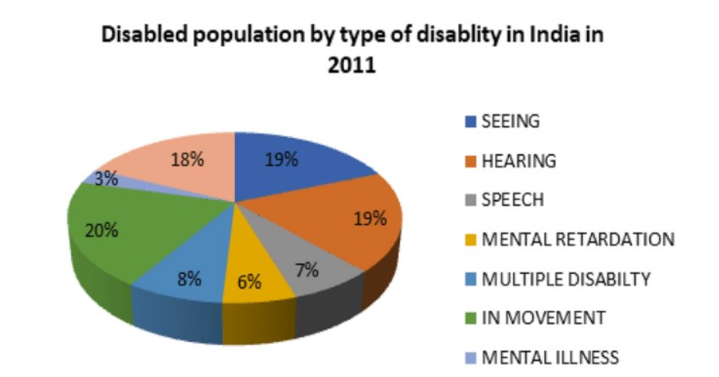
Key Points about DHH community in India
India has a large and growing Deaf and Hard of Hearing (DHH) population
According to the Census 2011, a total of 2.68 crore persons in India were reported as having disabilities out of which 19% have hearing disabilities.
Hearing disability is the second most prevalent disability in India
Severe shortage of certified
Indian Sign Language(ISL)
Interpreters (fewer than 300 for
Millions of users)

Slide 5
Problem Statement
Deaf users constrained by ISL inaccessibility to ∼90% hearing population (India Census 2021)
Persistent communication barriers between deaf/mute (∼15% global hearing loss, WHO 2024) and hearing populations
Indian Sign Language (ISL) lacks universal comprehension among hearing users
State-of-the-art deficits:
Unidirectional (sign→speech only)
Emotion-agnostic (ignores paralinguistic cues)
Resource-intensive
Need for a system that:
Support bidirectional communication
Preserves emotional tone
Works in real time

Slide 6
Objectives
Recognize Indian Sign Language (ISL) gestures in real time
Convert recognized signs into text and speech
Integrate emotion detection for expressive speech output
Enable speech-to-sign translation using animation
Build a lightweight, modular, scalable prototype

Slide 7
Literature Review

Slide 8
SL.No. | Paper Details | Key Innovation | Limitation
1 | Emotion-Aware Indian Sign Language Recognition: A Multimodal Approach With Sign-Expression Correlation Analysis Hriday Ranka et al. (2024) Educational Administration: Theory and Practice(EATP) | Multimodal LSTM (gesture)+CNN(emotion) | Computationally heavy, Unidirectional
2 | Real-time conversion of sign language to text and speech, and vice-versa Harshavardhan Latkar et al. (2024) TIJER | Integrating CNN-driven hand gesture recognition with NLP and speech modules | lacks emotion awareness, sentence-level context handling, and relies on heavy CNN pipelines

Slide 9
Sl.No. | Paper Details | Key Innovation | Limitation
3 | Real-Time Bidirectional Sign Language Translator Through Machine Learning R. Sivasankar et al. (2024) IJERT | Real time bidirectional conversion using CNNs and Mediapipe | lacks sentence-level construction, emotion awareness, and ISL-specific linguistic modeling
4 | Indian Sign Language Recognition using SURF with SVM and CNN Shagun Katoch et al. (2022) Elsevier | Uses SURF features with a Bag-of-Visual-Words model combined with SVM and CNN to achieve high accuracy for static ISL signs without special hardware. | Limited to static signs and word-level output, lacks sentence formation, emotion awareness, and real-time conversational bidirectional communication.

Slide 10
Research Gap

Slide 11
Research Gap
18
Lack of Emotion-Aware translation
One-way Communication focus
Heavy and Non-Real-time Models
Limited focus on ISL
Poor sentence level construction
Lack of User-Centric UI & Accessibility

Slide 12
Methodology

Slide 13
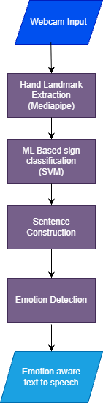
Two-Way Communication Pipeline
18
Deaf to Hearing

Slide 14
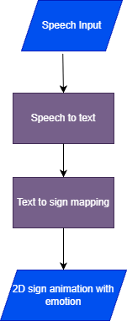
Two-Way Communication Pipeline
Hearing to Deaf

Slide 15
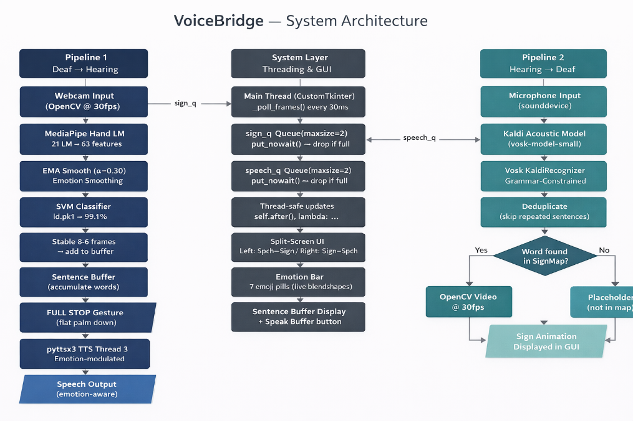
Two-Way Communication Pipeline

Slide 16
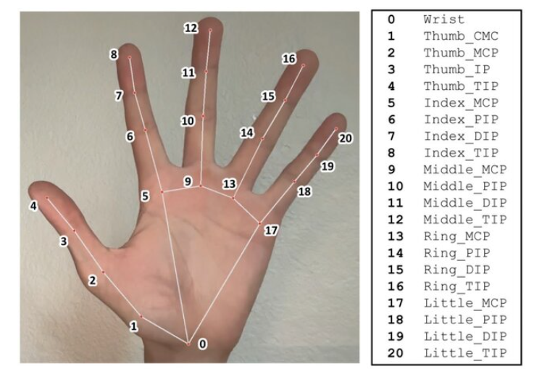
Module Explanation
Module 1: Data Acquisition
Custom ISL dataset collection
Hand landmark extraction (63 numerical features)
Labelled gesture
samples

Slide 17
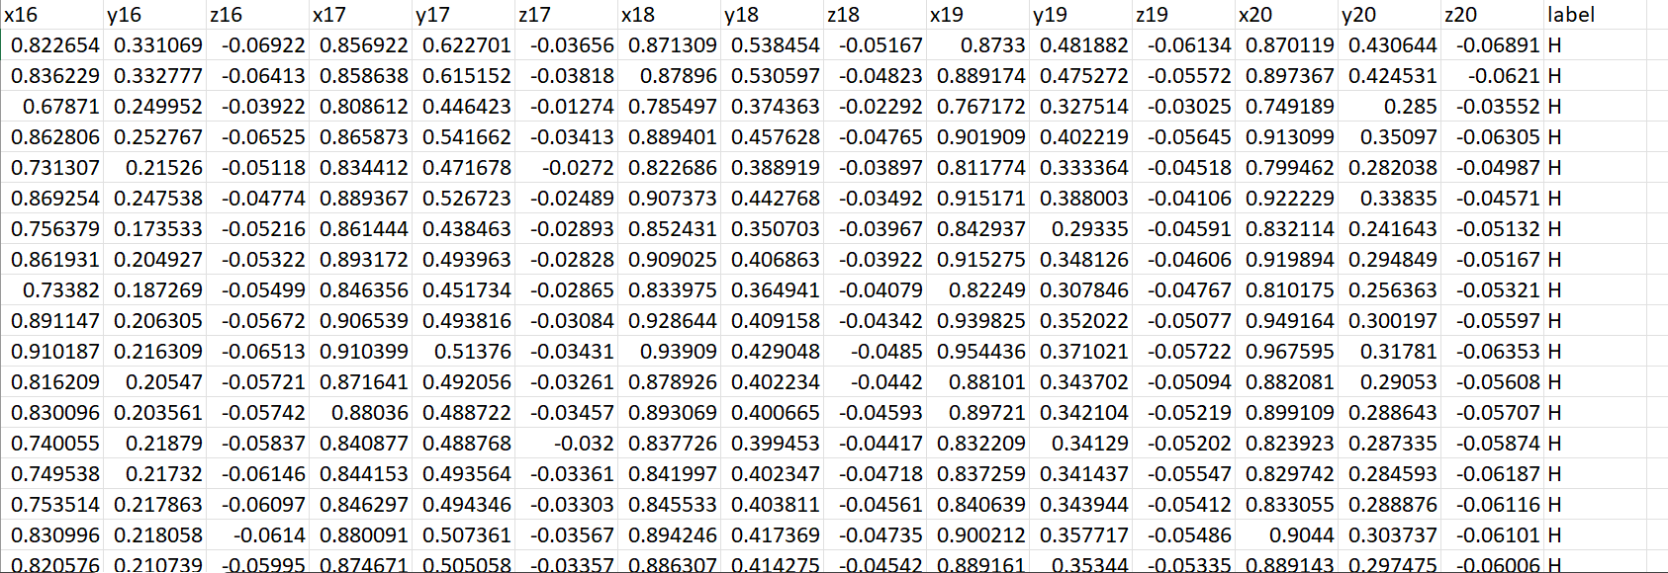
Module Explanation
Final dataset

Slide 18
Module Explanation
Module 2: Gesture Recognition
Feature scaling
ML classifier training(SVM)
Real-time prediction
Module 3: Sentence Construction
Temporal stability logic
Full-stop based segmentation

Slide 19
Module Explanation
Module 4: Speech Output
Word-level TTS(Google TTS)
Emotion-aware speech modulation
Module 5: Speech Acquisition
Live speech capture using microphone(Web Speech API)
Real-time speech-to-text conversion(SpeechRecognition API)
Noise-tolerant input handling

Slide 20
Module Explanation
Module 6: Text Preprocessing & Normalization
Removal of auxiliary words (is, are, am, the)
Conversion to ISL-friendly sentence structure
Tokenization into supported vocabulary
Module 7: Sign Mapping
Mapping processed words to ISL sign dictionary
Vocabulary-based lookup mechanism
Supports extensible sign set

Slide 21
Module Explanation
Module 8: 2D Sign Animation
Sequential display of ISL signs
Lightweight 2D animation rendering
Adjustable timing between signs
Module 9: Emotion Integration
Emotion tagging based on speech tone or context
Facial expression mapping for signs
Emotion-consistent animation playback
(Rule Based Mapping)

Slide 22
Module Explanation
Module 10: User Interface
Split-screen interaction (Hearing ↔ Deaf)
Display of recognized speech text
Visual sign animation output

Slide 23
Project Progress & Pending Work

Slide 24
Current Status
14
MediaPipe hand landmark extraction
Custom ISL dataset creation
ML model training & testing
Real-time sign prediction
Sentence construction logic
Word-by-word speech output
Full-stop based sentence segmentation

Slide 25
Pending Work
15
Emotion Detection → to be completed within one week
Emotion aware speech tuning →to be completed within one week
Speech to sign pipeline → By Feb 23
UI Integration → By Feb 28
Final Completion(Testing & Refinement) → By Mar 5

Slide 26
Thank You

